Slide 1
Preposition
A preposition is a word, which shows the relation of a noun or a pronoun to some other word in a sentence.
Meanings change according to the change of prepositions :-
1. The Teacher spoke to me.
2. The Teacher spoke for me.
3. The Teacher spoke about me.
4. The Teacher spoke against me.

Slide 2
Examples of prepositions denoting duration of time
Prepositions of Time: at, in, on
We use:
at for a Precise time
in for months, years, centuries, season, long periods
on for days and dates

Slide 3
Examples
at | in | on
PRECISE TIME | MONTHS, YEARS, CENTURIES and LONG PERIODS | DAYS and DATES
at 3 o'clock | in May | on Sunday
at 10.30am | in summer | on Tuesdays
at noon | in the summer | on 6 March
at dinnertime | in 1990 | on 25 Dec. 2010
at bedtime | in the 1990s | on Christmas Day
at sunrise | in the next century | on Independence Day
at sunset | in the Ice Age | on my birthday
at the moment | in the past/future | on New Year's Eve

Slide 4
Notice the use of the preposition of time ‘at’ in the following standard expressions:
Expression | Example
at night | The stars shine at night.
at the weekend | I don't usually work at the weekend.
at Christmas/Easter | I stay with my family at Christmas.
at the same time | We finished the test at the same time.
at present | He's not home at present. Try later.

Slide 5
Since vs For
For | Since
Specific period | Starting point of a period
I have been a doctor for 15 years. | I have been a doctor since 1992.
My sister has lived in frankfurt for 9 years. | My sister has lived in frankfurt since the beginning of March.

Slide 6
Ago
Back in the past
E.g.: The dinosaurs died out 65 million years ago.
Six years ago I knew everything, now I know nothing.

Slide 7
Test on Since, For, ago
I have known him ___________ years.
I went to the USA five years __________.
I have been 18 ________ September.
What have you done until now, ________ the last time we met?
How long have you worked for them? ________ 1965.
They have been married _________ several years.
__________ I have worked here I feel good about it.
I saw him 3 days ___________.
Notes:
Answers: for, ago, since, since, since, for, since, ago.

Slide 8
Answers
for, ago, since, since, since, for, since, ago

Slide 9
Before and After
Before is previous to a time and after is subsequent to a time.
e.g.: ten o’clock is before 11 o’clock
Three o’clock is after two o’clock

Slide 10
During
For part of a period
e.g.: He slept during the day.
He was reading during his journey from Germany To Mumbai.

Slide 11
THROUGHOUT
for an entire period.
e.g.: He slept throughout the day.

Slide 12
TOWARDS
nearing a period of time.
e.g.: It was towards evening when she called.

Slide 13
BETWEEN
after a time, and before another time.
e.g.: They will arrive between five and six.

Slide 14
WITHIN
between now and a length of time.
e.g.: They will be here within ten minutes.

Slide 15
BEYOND
after a time
e.g.: Our guests stayed beyond midnight

Slide 16
Until/till
up to, but not after a time.
e.g.: The party will last until ten

Slide 17
In time or On time
in time—not too late for an event Try to get here in time to help me.
on the dot—at the exact minute Please come on time.

Slide 18
While
While is used to talk about two things that are happening at the same time.
e.g.: The phone rang while I was watching T.V.

Slide 19
Test on During, while, for
I have been meaning to call you _______ some time.
He fell asleep ___________ the meeting.
We all stayed inside ________ the storm.
Someone stole my bag ________ I was riding on the train.
The dog was barking __________ she was trying to watch T.V.
Please don’t smoke ______ I am eating.
Bats sleep _________ the day.

Slide 20
Test on During, while, for
8. They have been out of the office ________ ages.
9. He kept talking to me ________ I was trying to read.
10. His mobile phone rang twice _________ the film.

Slide 21
Answers
For
During
During
While
While
While
During
For
While
During

Slide 22
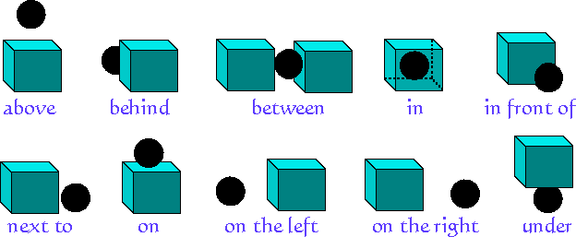

Slide 23
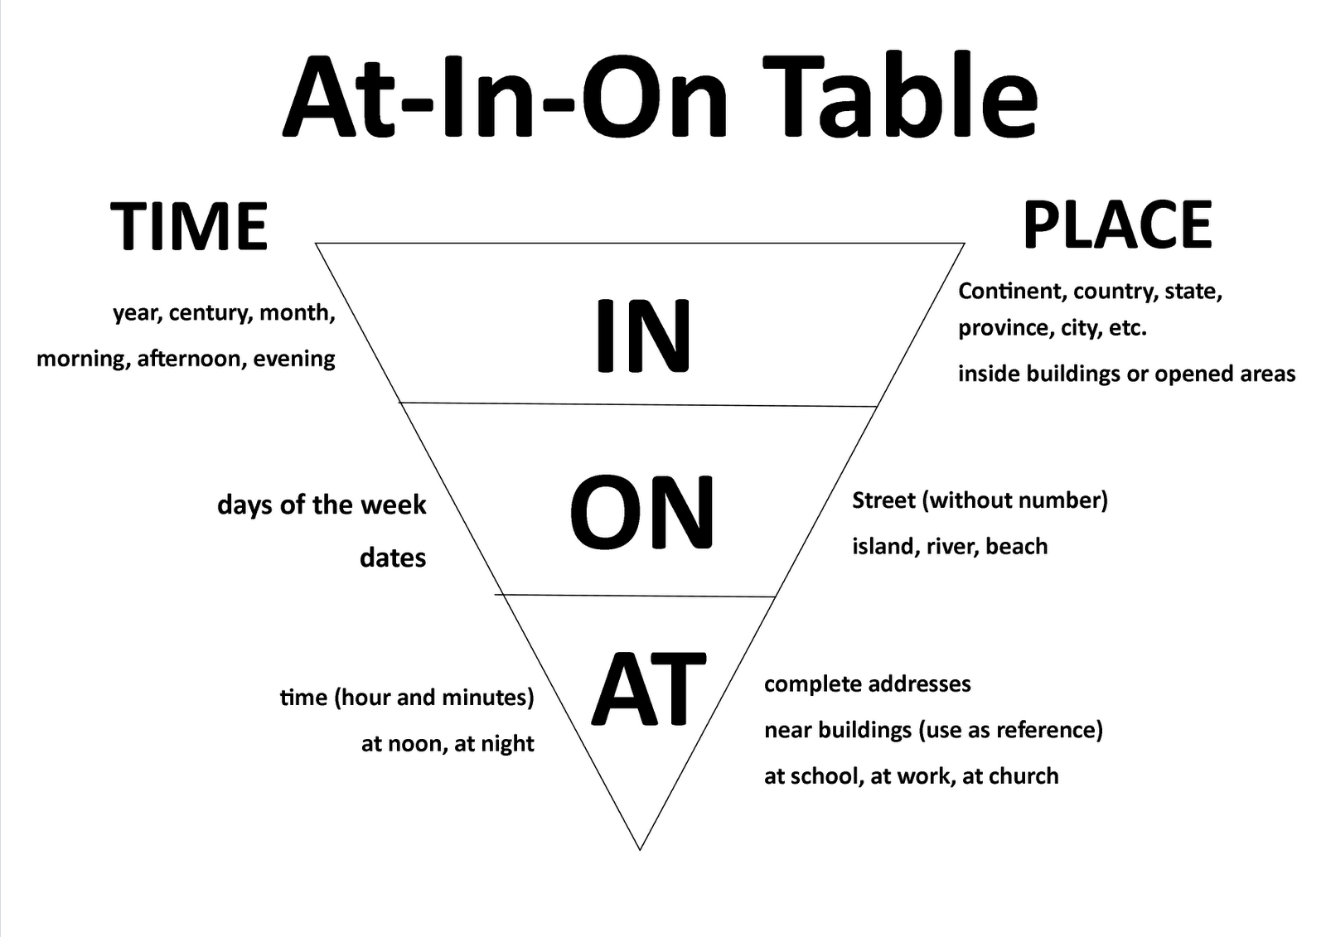
IN ON AT for places and position

Slide 24
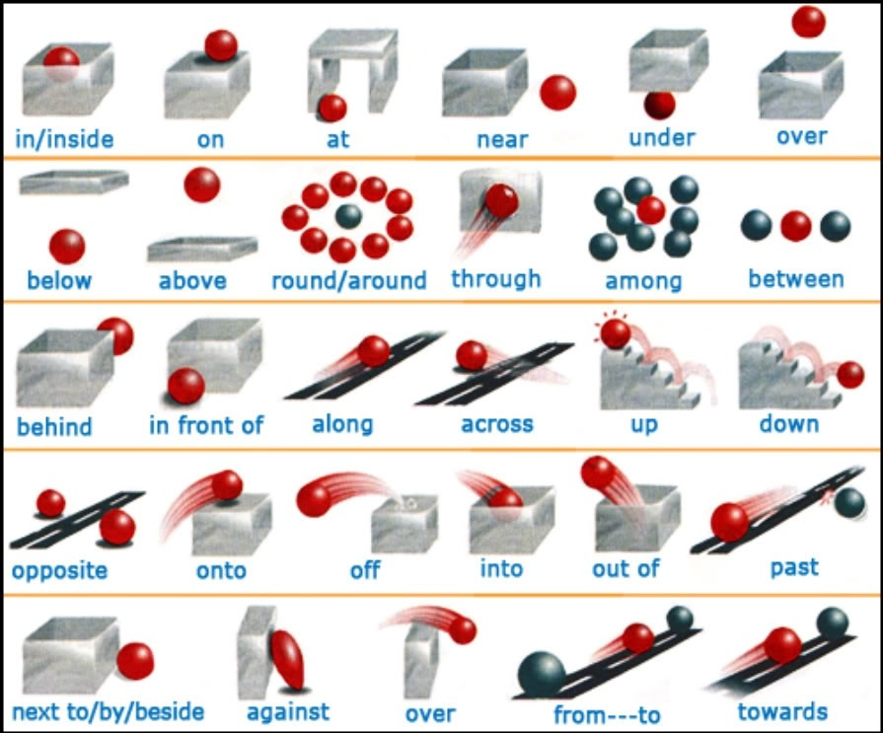

Slide 25
beside/besides
Beside and besides have altogether different meanings.
Beside: at the side of.
Besides: in addition to/ as well as.
Ex.
He was sitting beside me.
Besides a car, he also has a flat.

Slide 26
In/Into
In | Into
Presence | Movement
I am in the library. | I am walking into the library.
There is mouse in my house. | I saw the mouse creeping into my house.
The cheese is in the refrigerator. | He put the cheese into the refrigerator.
Notes:
creeping : to move slowly with the body close to the ground, as a reptile or an insect, or a person on hands and knees.

Slide 27
In/within
In means the max time limit while within means the period upto which the work will be completed.
Within, a particular length of time, means before that length of time, while in refers the max time requires for the completion of the job.
Ex. I will complete the work in a month.
I can repair the Car within two hours.

Slide 28
of/off
Of | Off
Connection | Disconnection
I am the brother of Jeniffer. | Jenniffer ran off.
A story of hats. | My hat fell off.
belonging to someone | removed
They are colleagues of mine. | you can take off your hat.
She has a fear of the dark
numbers, dates, ages | Not operating
We have a girl of five. | Turn off your computer
He predicted an increase of 2 % | The electricity is off.
It was the 1st of May 2013

Slide 29
of/off
Consisting of | canceled
Please give me a glass of water | The wedding is off.
Used to show which one | far away
The year of 1956 | Your birthday is a long way off
The city of New York
used to show characteristic | less
He is a man of great power. | The shirts are $5 off.
This is a matter of no importance.

Slide 30
below/under/beneath
Below and under both mean lower than (a level) and something either can be used. But under usually denotes physical contact and below denotes space between the things.
Ex. He put the books under the pillow.
They live below us.

Slide 31
Below
talk about level of something:
It’s supposed to drop below freezing tonight.
talk about something later on:
Please read the instruction below before you begin.

Slide 32
Beneath
Something that is beneath another thing is under the other thing.
Ex. I could see the muscles of his shoulders beneath his T-shirt.
I found pleasure in sitting beneath the trees.
Beneath could also mean unworthy as per status or in lower social class
Ex. It is beneath his dignity to beg for money.

Slide 33
Since/For/ From
For | Since
Specific period | Starting point of a period
I have been a doctor for 15 years. | I have been a doctor since 1992.
My sister has lived in frankfurt for 9 years. | My sister has lived in frankfurt since the beginning of March.

Slide 34
From
From is normally used with to or till/until.
Ex. Most people work from eight to six.
From is also used of place.
Ex. He is from pune.

Slide 35
For/during
During is used with known period of time i.e. periods known by name such as Christmas, Easter or periods which have been already defined.
For has various other uses.
Ex. It rained all Sunday, but stopped raining during the night.
She was ill for a week, and during that week she ate nothing.
He asked for ten.
He has been ill for 3 months.

Slide 36
ago/before
Ago is used for past events while before is used in reference to two events.
He came 3 days ago.
The train had left before he reached the station.

Slide 37
On/onto
On can be used for both existing position and movement.
Ex. He was sitting on his bag.
Snow fell on the hills.
Onto is used when there is movement involving a change of level.
Ex. People climbed onto their roofs.
He lifted her onto the table.

Slide 38
Between/ Among
Between is used for two things or persons but it can be used of more when we have a definite number.
Ex. He distributed his property between his two sons.
Among is usually used for more than two persons or things.
Ex. He was happy among all friends.
Among and amongst have the same meaning.
For vowel sound amongst can be used.

Slide 39
Above/ Over
Above and over both means higher than and sometimes either can be used.
He lives over this mountain.
He is over me.
I put a cloth over her.
Over is used with meals/food/ drink.
Ex. We had a chat over a cup of coffee.
The matter was decided over the lunch.

Slide 40
To/towards
The preposition indicates movement with the aim of a specific destination.
Ex.
I am going to USA tomorrow.
I need to go to the bank.
Towards indicates movement in a particular direction
Ex. Everyone sitting in a room turned towards me.
She was carrying a suitcase and walking towards the railway station.

Slide 41
Made from /made of
Both refers material used.
Made of is used when the shape of the material is not changed.
Ex. A notebook is made of paper.
A house is made of bricks.
Made from is used when shape of the material has undergone change.
Ex. Butter is made from milk.
Paper is made from grass.

Slide 42
Across/along
Across is used to talk about movement from one side of a place to another.
Ex. It is the first time I have flown across the Atlantic.
Along is used to show movement following a line.
Ex. We walked along the river along the railings.
Well wishers began placing flowers.

Slide 43
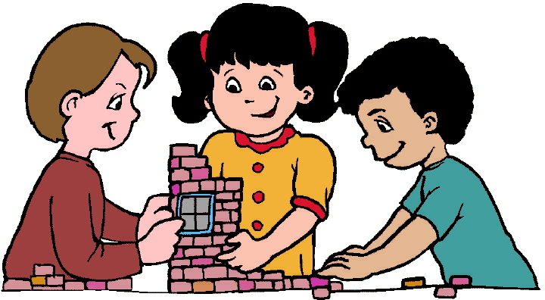
Activity - Locate your address
Notes:
Locate your address with the help of prepositions.

